Slide 1


CIRA Labs
Secure Home Gateway
Project Vision - 2019
SECURE HOME GATEWAY PROJECT
May 2019
Notes:
Consider starting with a story of your vision – how did this come to be?

Slide 2




Project Evolution – From Idea in late 2016
In the home
Gateway
Need security access controls
Has to be easy to use
MIRAI Dyn Attack
October 2016
x
x
?
Need a new framework to prevent lightbulbs from killing the internet!

Slide 3
The many problems of today’s Home Gateway
No Standard Home Network Security Framework
No outbound traffic security controls
No standard onboarding process
Not globally reachable (no domain name)
Home
Gateway
No visibility on network activities
No unique WIFI keys per home device
No device quarantining processes

Slide 4





IoT Device Security Landscape
Many are Vulnerable
Software is out of date
Cloud architecture dependencies
Full access to the ENTIRE Internet
Some are Unsupported
Time to market -
Not to build correctly
Many standards being developed
Lack of secure testing and design
Require active monitoring
Contribute to DDoS attacks
Steal private information
Steal WIFI credentials
Send spam
Compromise your network
Record video and voice
Distribute malware

Slide 5





IoT vendors are creating dependency on cloud architecture
IoT Cloud
Services
IPv6 with CIRA delegated names for the home makes this possible
Personal information is of great value to vendors
On the road
At home
Direct is better

Slide 6
Project Evolution – To a Secure Home Gateway (SHG) Prototype
openWRT
Turris Omnia
CZNIC
MUD Server Repository / Curation
SHG MUD Controller
Supervisor
SHG App “Ease of Use”
SIDN (.NL) SPIN
SHG Security Access Controls
Running
Code
Proposed
Standards
prpl Foundation
(prplWrt)
Secure
Home
Gateway
CIRA
DNS & SHG Provisioning
Mozilla IoT -
Web Thing API
Secure Home Gateway Framework
Standards Development
IETF, CSA/UL, ISO/IEC
Enhanced WIFI security
In progress:
DOTS, DNSSEC, Domain aware NFtable

Slide 7









Best practices – Apply enterprise security framework to home networks
Home Security
PDAP
Appliances
PDAP
IoT Cloud
Services
Sensors
PDAP
Management
Application
PDAP: Per Device Access Policy
Scale Enterprise solutions to fit the home network
Notes:
-> best practices and new standards (note to Jacques – please explain Per Device Access Policy (PDAP) for those who may not understand what it means)
Rule #1: Identify IoT devices on your home network
Rule #2: Place a policy around the IoT device that restricts it to a specific function (default is no access)
Rule #3: Monitor for behavioural changes in the device and quarantine at the first sign of change.

Slide 8

How networks are weaponized
Businesses
services
Root name
servers
Home Security
PDAP
Appliances
PDAP
Social
Media
Sensors
PDAP
Critical
Infrastructure:
Power, gas, 911
Management
Application
Notes:
-> best practices and new standards (note to Jacques – please explain Per Device Access Policy (PDAP) for those who may not understand what it means)
Rule #1: Identify IoT devices on your home network
Rule #2: Place a policy around the IoT device that restricts it to a specific function (default is no access)
Rule #3: Monitor for behavioural changes in the device and quarantine at the first sign of change.

Slide 9

How networks are weaponized
Wide-open
UPnP
ATTACK
Critical
Infrastructure:
Power, gas, 911
Notes:
-> best practices and new standards (note to Jacques – please explain Per Device Access Policy (PDAP) for those who may not understand what it means)
Rule #1: Identify IoT devices on your home network
Rule #2: Place a policy around the IoT device that restricts it to a specific function (default is no access)
Rule #3: Monitor for behavioural changes in the device and quarantine at the first sign of change.

Slide 10




New standards – MUD - Manufacturer Usage Description – RFC8520
I’m an ACME water sensor
- MUD File at: https://acme.corp/mud/ws1.0.json
MUD FILE:
- I have WIFI & apply the water sensor access policy
- I need to upgrade my firmware at https://acme.corp
- Configure me at https://myip/setup
- Alerts available at https://myip/alerts
It would be nice if the IoT device could advertise it’s current firmware version and/or current MUD file URL via WIFI or network connection (DPP, DHCP, LLDP…) on order to setup correct security profile

Slide 11


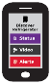






SHG
ACME.CORP
MUD
Repository
(1)
CIRA SHG
MUD Repository
MUD Supervisor
(3)
User accepts
provisioning
instructions
(2)
Send to
CIRA
(2)
Get vendor
MUD file
SHG
App
MUD Controller
(IP Tables)
(4)
IoT device added to network with specific network access controls
Network Access control:
Allow access to ACME.CORP
Allow to send alerts internally
Allow to be configured by app
Deny all other internet access
(1)
(4)
(1)
Scan MUD
QR code &
send to MUD
Controller
(DHCP in future)
MUD QR Code
ACME.CORP
IoT Water Sensor
Notes:
High Level MUD & IoT Device Provisioning Workflow

Slide 12
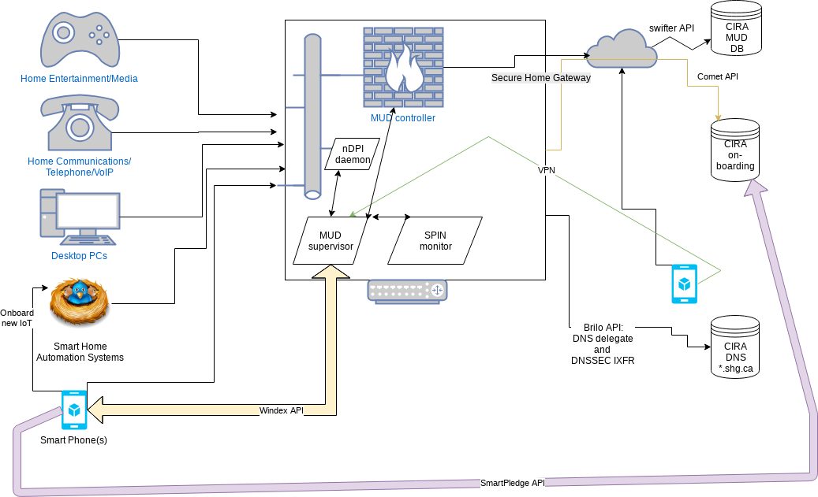
Work in progress architecture

Slide 13
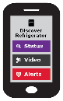



Step 2 – Secure Home Gateway setup
BRSKI enrollment of with disconnected Registrars – smarkaklink
This document details the mechanism used for initial enrollment using a smartphone of a BRSKI Registrar system.
…where the registrar device is new out of the box and is the intended gateway to the Internet (such as a home gateway),
but has not yet been configured…
SHG
application
kaklink ☺
https://datatracker.ietf.org/doc/draft-richardson-anima-smarkaklink/
Notes:
Follow the configuration instructions
Install & open the CIRA SHG App
Power on the SHG
Scan the SHG QR code for initial setup
System Assigned 3rd level domain name
Setup split view Internet/External DNS for SHG domain
Home Gateway ready for configuration

Slide 14
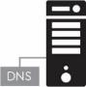




Step 3 – External DNS/DNSSEC Provisioning
Internal
DNS view
Secondary DNS
D-Zone
SHG External
IP Address
SHG External
Domain Provisioning
& Primary DNS
External
DNS view
Hidden Primary
Notes:
Automated DNS Backend Provisioning @ CIRA
CIRA creates the 3rd level .CA SHG domain w/DNSSEC
SHG and CIRA sync on external view propagation, internal SHG DS record synced in external DNS view. (full chain of trust internally and external on SHG domain)
Need synchronisation between external SHG DNS record and SHG external IP address

Slide 15





Step 4 – Automated Wi-Fi setup
MUD profile
Wi-Fi credentials
Device access policy
Scan
Notes:
Current focus is on automated Wi-Fi setup – that’s challenging!
Setup secure home network infrastructure
Using your SHG App, scan the QR code of each new device to:
Discover the MUD profile
Transfer the unique WIFI credentials (per MAC address)
Assign the appropriate Device Access Policy

Slide 16
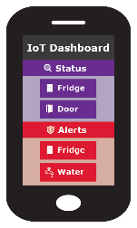
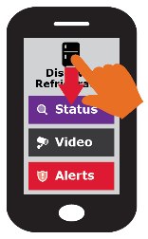
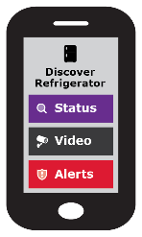




Simple user interface is key to this project
Swipe UP, DOWN, LEFT and RIGHT
Notes:
Gateway provisioning, device discovery, device provisioning must be as simple as possible, intuitive for non experienced users, available as framework for default open source app.

Slide 17
Want more info?
Visit the CIRA Labs page and as well as GitHub
https://cira.ca/cira-secure-home-gateway
https://github.com/CIRALabs/Secure-IoT-Home-Gateway
Don’t forget to share your feedback and input, open a github issue!
Notes:
For an informational version of this deck that includes:
High level architecture graphic
More details on the proof of concept and prototype
Specifications we are currently leveraging

